Slide 1
Capstone Project - The Battle of the Neighborhoods
Applied Data Science Capstone by IBM/Coursera

Slide 2
Table of contents
Problem Background
Targeted Audience
Data
Neighborhood Candidates
Methodology
Analysis
Results and Discussion
Conclusion

Slide 3
Problem Background
Barcelona city is one of the most populous cities of Spain and in this assignment we’ll be conducting an analysis to find the optimal location of starting a new Italian restaurant.
Targeted Audience
People of Barcelona and tourists who would like to try a foreign restaurant.

Slide 4
Data
We’ve collected out data from three websites:
Wikipedia
Google Maps API
Foursquare API

Slide 5
Neighborhood Candidates
We’ve found the latitude & longitude of Barcelona city center, using specific, well known address and Google Maps geocoding API.
Coordinate of Barcelona, Spain: ['lat': 41.3850639, 'lng': 2.1734035]
In Cartesian: X=-573518.9890965135, Y=4661662.499852937

Slide 6
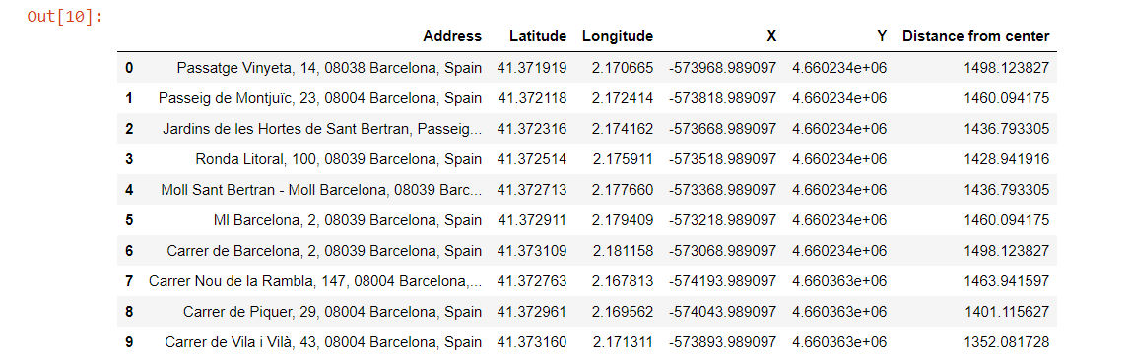
Neighborhood Candidates
Addressed of neighborhoods in a Pandas DataFrame:

Slide 7
Foursquare
We’ve used Foursquare API to get information about the number of restaurants in the city.
Total number of restaurants: 1,080
Total number of Italian restaurants: 66
Percentage of Italian restaurants: 6.11%
Average number of restaurants in neighborhood: 25.3

Slide 8
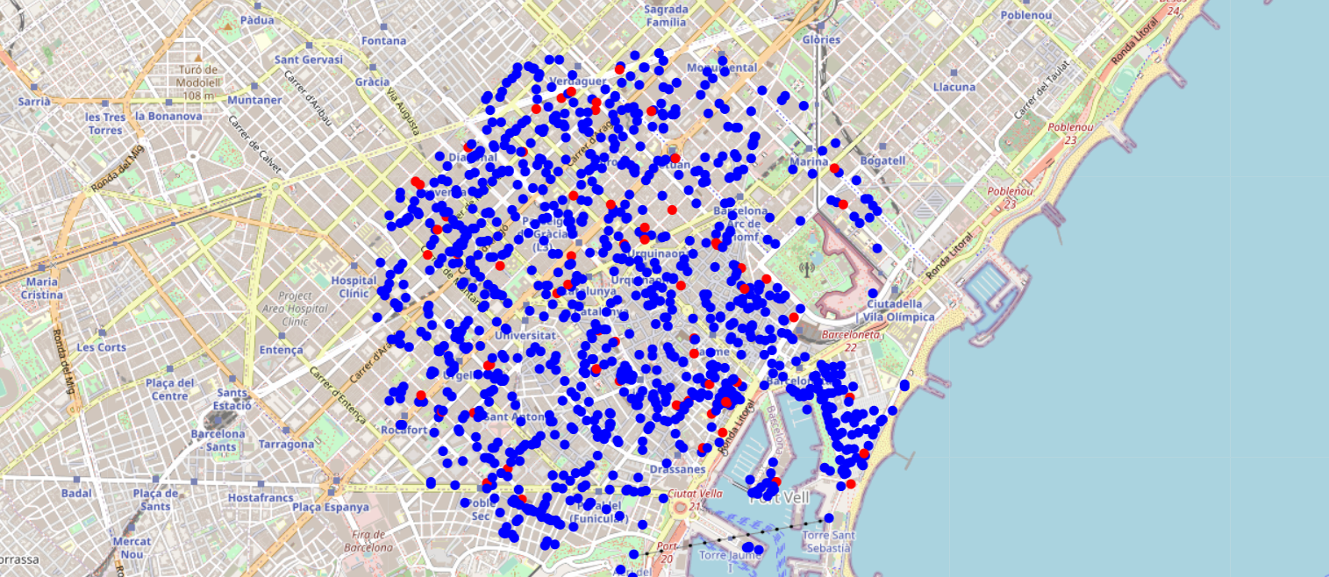
Foursquare
Number of restaurants (blue dots) and Italian restaurants (red dots).

Slide 9
Methodology
We’ll choose the location with the least crowded restaurants in the city.
This will be our optimal location to launch the first branch of out restaurant.
We’ll use k-means clustering when needed to compare and decide which neighborhood will be picked.

Slide 10
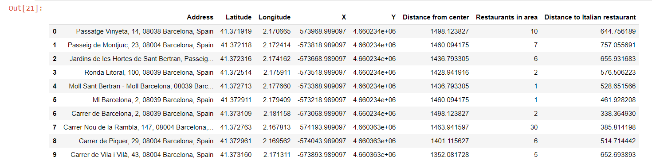
Analysis
Distance to nearest Italian restaurant from every area in the DataFrame:

Slide 11
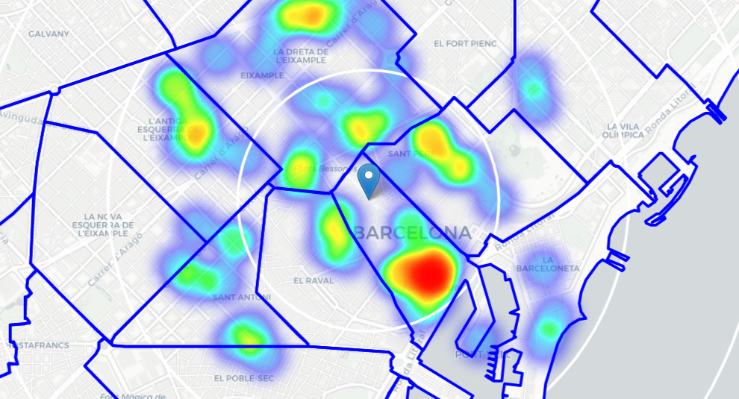
Analysis
On average, Italian restaurant can be found within ~220m from every area center candidate.
A heatmap showing the density of Italian restaurants in the city:

Slide 12
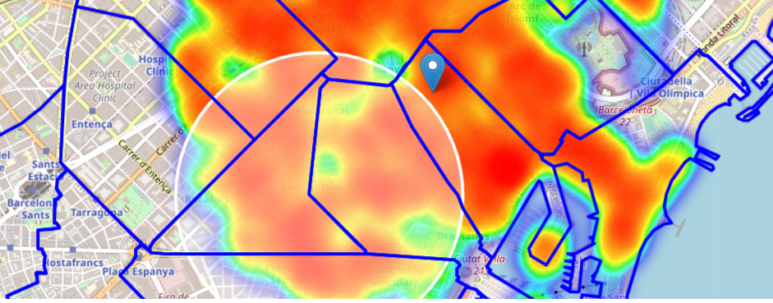
ANALysis
We’ll narrow down our search to two neighborhoods: “El Raval” and “Sant Antoni”.
The circle was shifted to be in the middle of these two neighborhoods.

Slide 13
Analysis
We’re only interested in the locations which meet the following conditions:
No more than five restaurant in the vicinity of 100 m.
No Italian restaurant within 200 m.

Slide 14
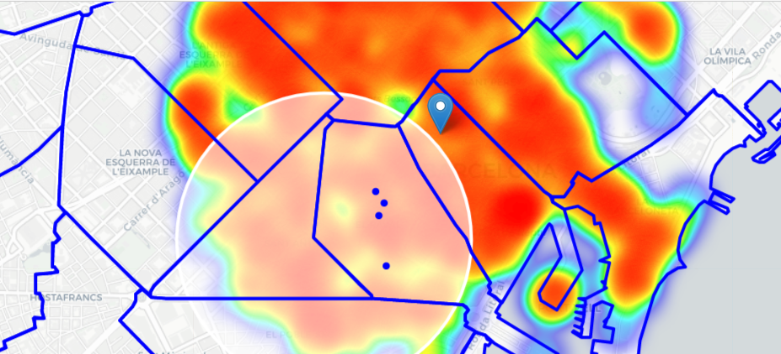
analysis
Four locations were found:

Slide 15
Results and Discussion
Since we’ve found four location and both are close to each other and are in one neighborhood (El Raval), we don’t need additional analysis or clustering.
We’ve specified two conditions:
No more than five restaurants and no Italian restaurant within 100 m.

Slide 16
conclusion
Using the help of Google and Foursquare APIs as well as information about the city from Wikipedia, we have calculated and obtained important information about the city’s popularity and numbers of restaurants in its neighborhoods.
We have found four optimal locations to launch our restaurant.
The final decision of where the location would be the stakeholder’s.

